Slide 1









The growing Phenomena of
Anime
(EDA)
Anime
(EDA)
Yeng Russian

Slide 2




Agenda
Closing
statement
Data
Processing
Data
Presentation
Conclusions.
Limitations.
Manipulate the data to answer the Research Questions.
Present pertinent Graphs.
Explain the results.
Introduction to the topic:
Anime definition.
Characteristics.
Importance of Research.
Research Questions.
Data Overview.
Data pre-processing
Clean the data (NaN values, duplicates and more).

Slide 3



01.
Anime Definition
A style of animation originating in Japan.
It covers a wide range of genres, themes and topics.
Appeals to various age groups and interests.
Characterized by vibrant colors, exaggerated facial expressions, and unique character designs.

Slide 4



02.
Importance of Research
Make informed decisions about the anime industry.
Identify Audience Preferences.
Identify Popularity Trends.
Guide the decision-making process and generate business value.
Investment Opportunities

Slide 5


03.
Research Questions
Which animes have the highest and lowest user scores?
What is the relationship between Score and Votes?
Is there any anime with a high number of Votes but a low Score?
How does Popularity rank correlate with Score?
What are the most common age Rating categories?
How has the average score of anime evolved?
Are animes with more Episodes generally higher scored?
How does the status of the anime affect the score?
What are the most common Source materials for high-scoring anime?
What are the most common duration of Episodes?
Do shorter or longer anime (Duration) tend to have higher scores?
What are the most common episode counts?
What is the relationship between Popularity and Votes?

Slide 6

04.
Data Overview
Title: Title of the anime (Jap & Eng).
Score: Score given by users (out of 10).
Votes: Number of user votes for the anime.
Ranked: Rank of the anime based on score.
Popularity: Popularity rank.
Episodes: Number of episodes.
Status: Current airing status (e.g., Finished Airing).
Aired: Airing period.
Premiered: Premiere season and year.
Producers: Production companies.
Licensors: Licensing companies.
Studios: Animation studios.
Source: Source material (e.g., Manga).
Duration: Duration per episode.
Rating: Age rating.

Slide 7



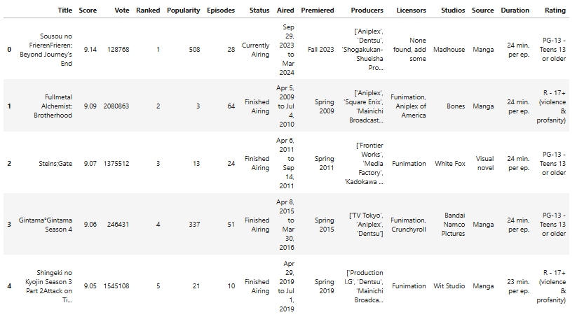
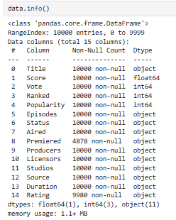
Read Dataset
Quick overview
05.

Slide 8

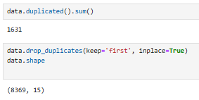
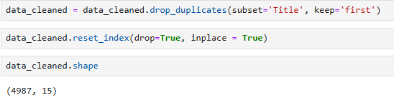


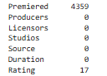
01.
03.
Duplicate values
Duplicate Titles
& Reset index
Data
Preprocessing
02.
Nan values
nan_count_per_column = data.isna().sum()
print(nan_count_per_column)
17 rows in Rating should be eliminated, this represents 0.2% of our sample:
06.
data_cleaned = data.dropna(subset=['Rating'])

Slide 9

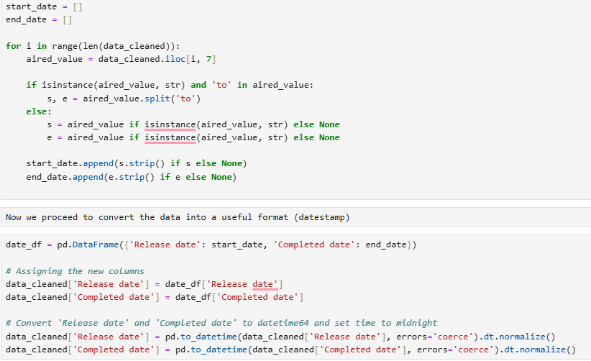
Convert object
to datestamp
07.

Slide 10
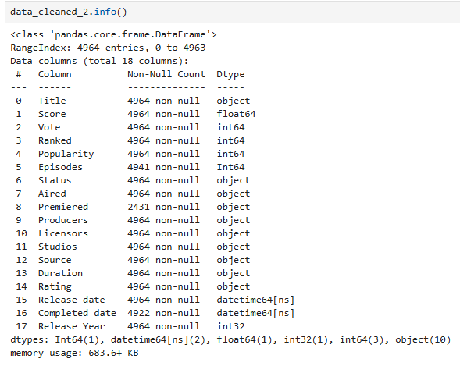
Final dataset
08.

Slide 11
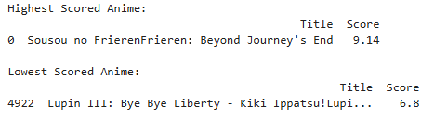

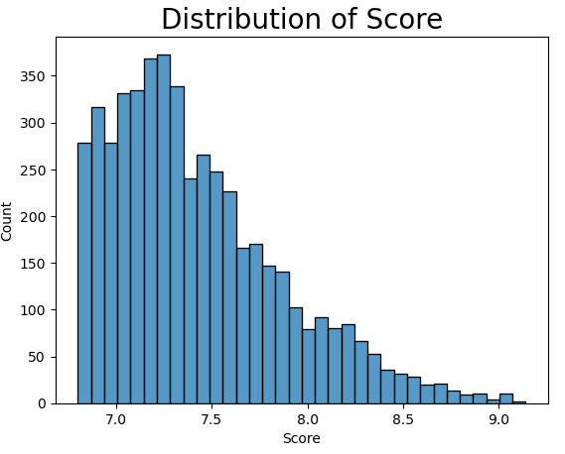
highest_score_anime = data_cleaned_2[data_cleaned_2['Score'] == data_cleaned_2['Score'].max()]
lowest_score_anime = data_cleaned_2[data_cleaned_2['Score'] == data_cleaned_2['Score'].min()]
print("Highest Scored Anime:")
print(highest_score_anime[['Title', 'Score']])
print("\nLowest Scored Anime:")
print(lowest_score_anime[['Title', 'Score']])
Highest/Lowest
Score
09.

Slide 12


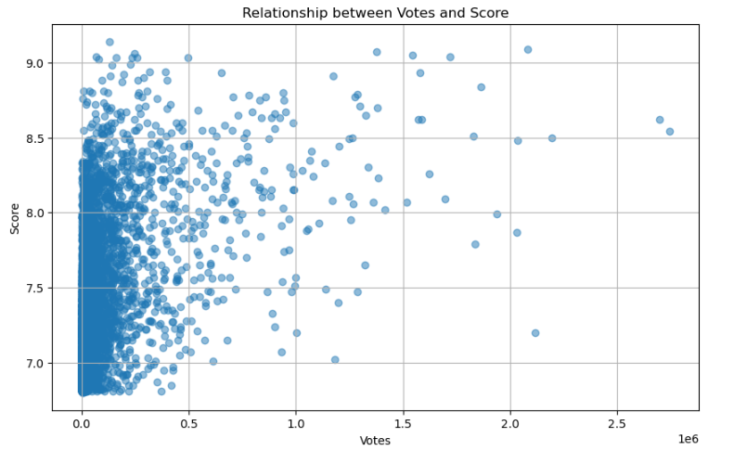
Positive correlation
Score
vs
Votes
0.42
Votes
Score
This suggests a potential relationship between anime with higher engagement are perceived as higher quality
possible reasons
Popular anime are well received by the audience.
High score animes attract more viewers (and more votes).
10.

Slide 13
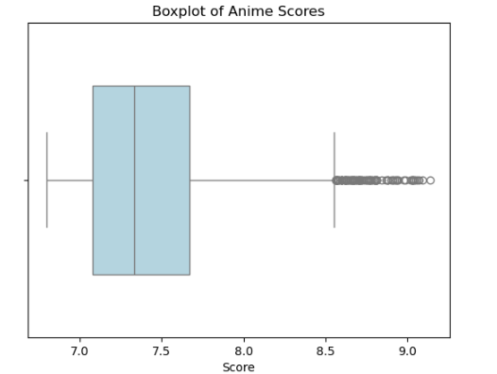
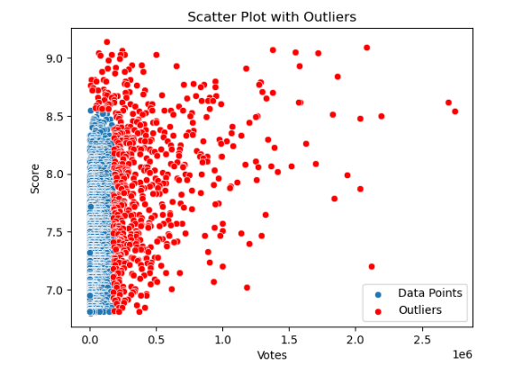
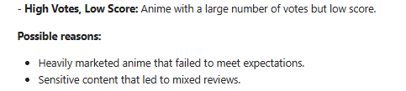
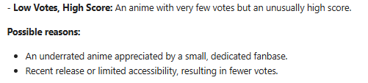
Outliers
11.

Slide 14

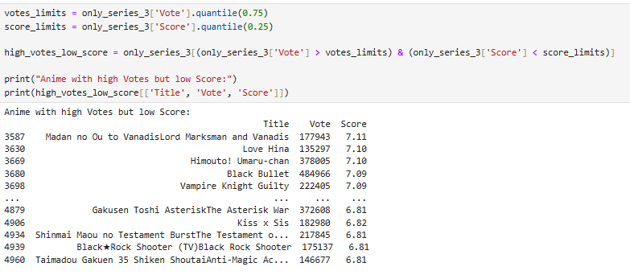

There are animes with many votes and low scores, but there is no case that an Anime has a low score with a great amount of votes.
high number of Votes but low Score
12.

Slide 15



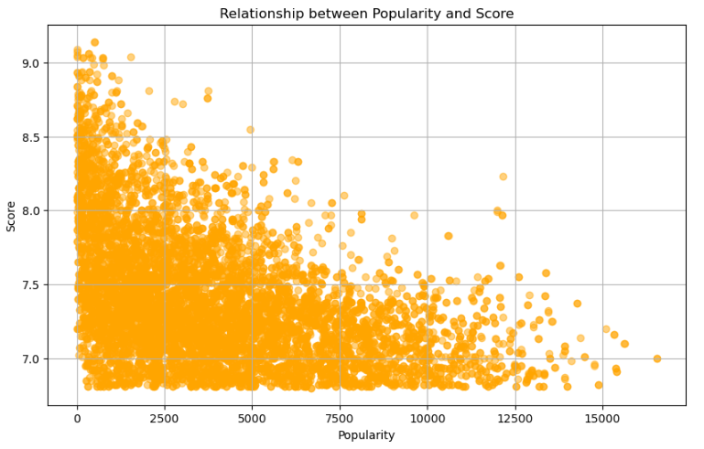

Popularity
vs
Score
Correlation: -0.45
A highly rated anime (higher Score) often becomes more popular, resulting in a low Popularity rank. Conversely, anime with lower Scores are less likely to achieve top popularity rankings.
Popular anime tends to be high quality: This could indicate that audiences generally favor and vote for anime that are critically acclaimed or well-made.
13.

Slide 16
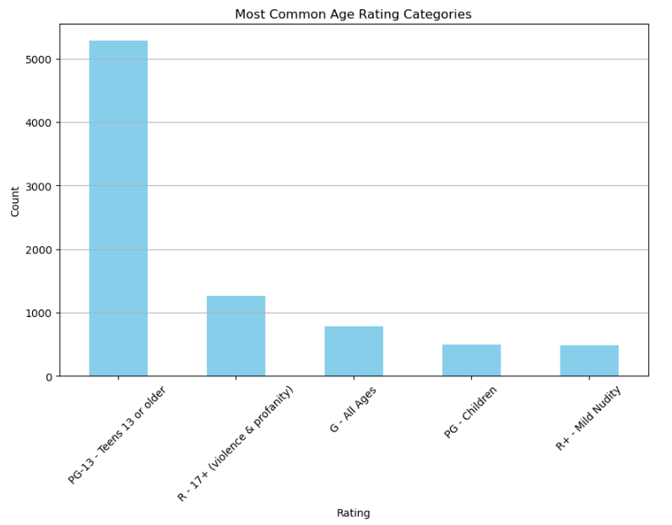




Age Rating
Categories
14.

Slide 17
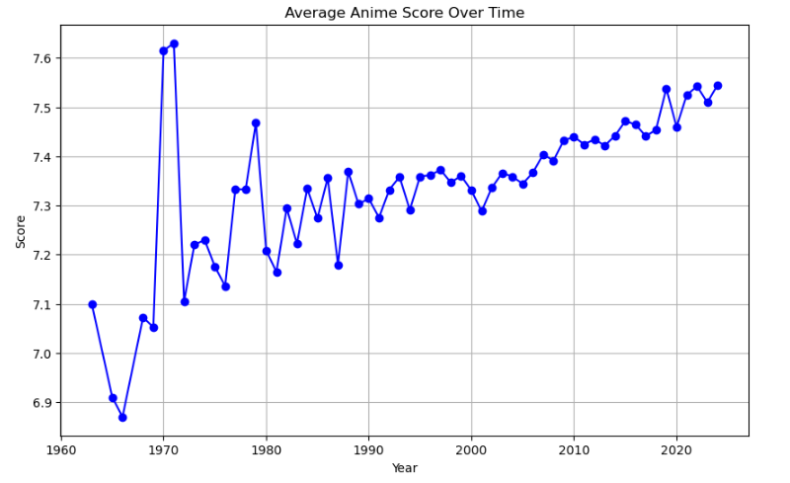

score evolution overtime
This graph suggests that there
is a slight upward trend in the
average score over the years.
15.

Slide 18

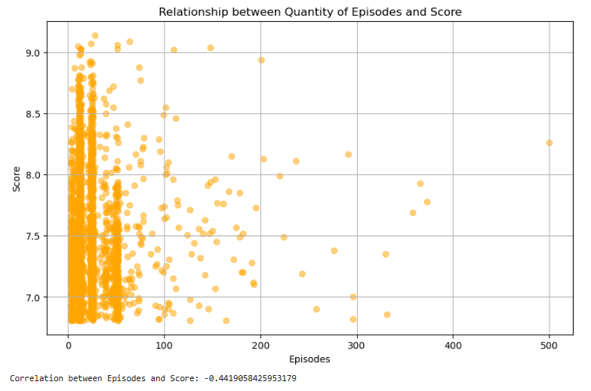

Episodes
vs
Score
The correlation is negative and near zero (not very strong).
However this means that the variables are inversely proportional,
meaning that the higher the score, the less the quantity of Episodes.
16.

Slide 19
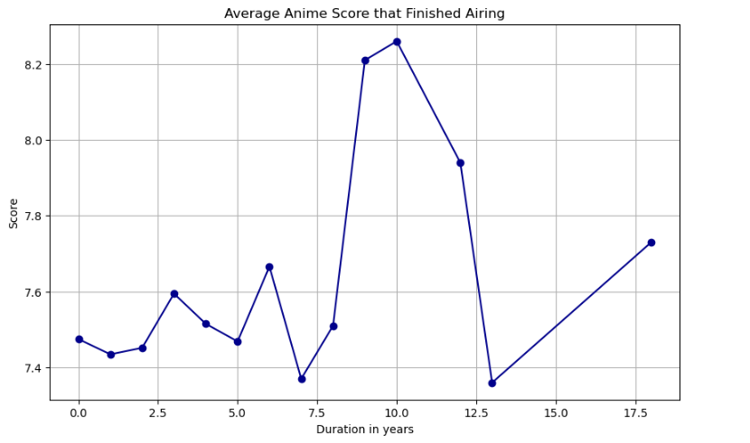
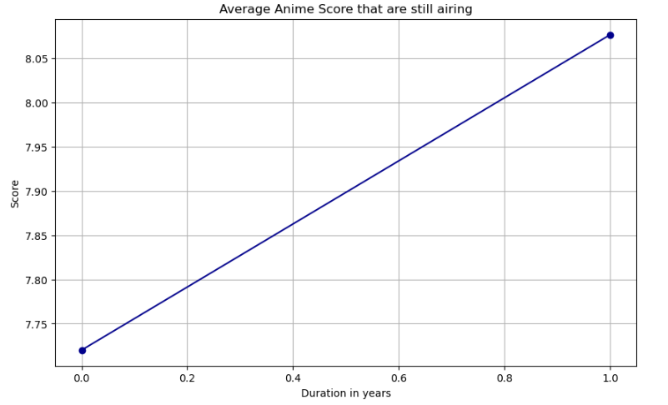
Status vs Score
17.

Slide 20

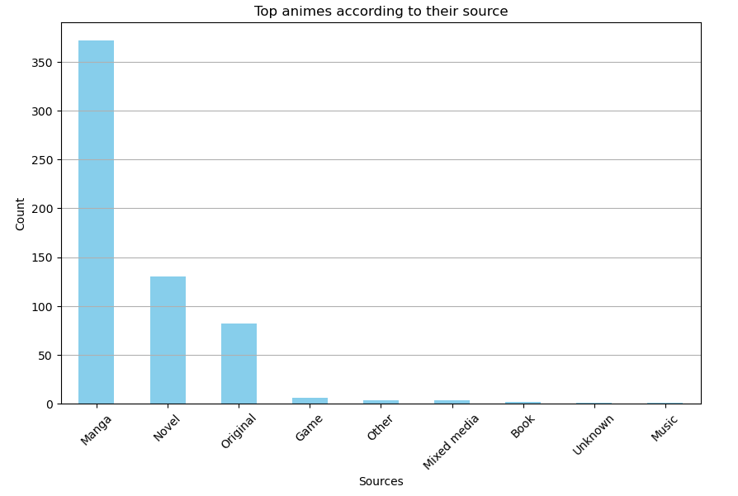






Most common Sources
Manga
Novel
Original
18.

Slide 21


Average duration per Episode
24 minutes
The range is between 22 - 26 min per episode
19

Slide 22
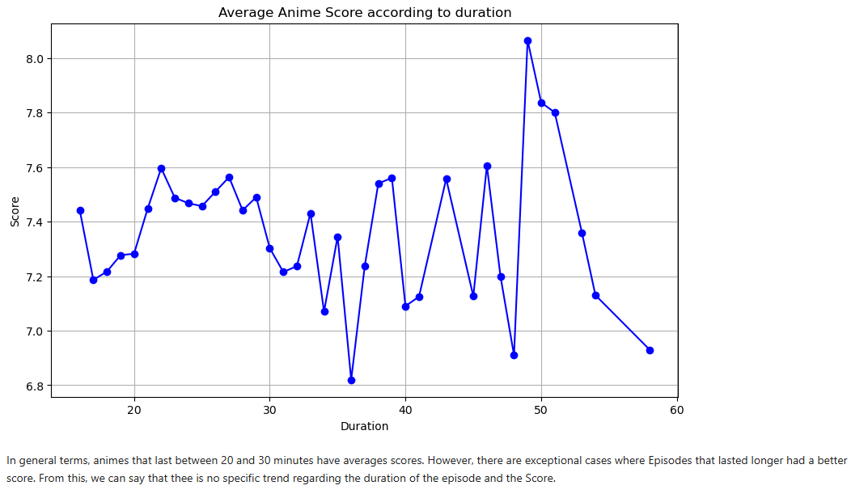
Duration
vs
Score
20

Slide 23



Amount of
Episodes
Mixed
Results
24-26
Episodes
12-13
Episodes
21

Slide 24
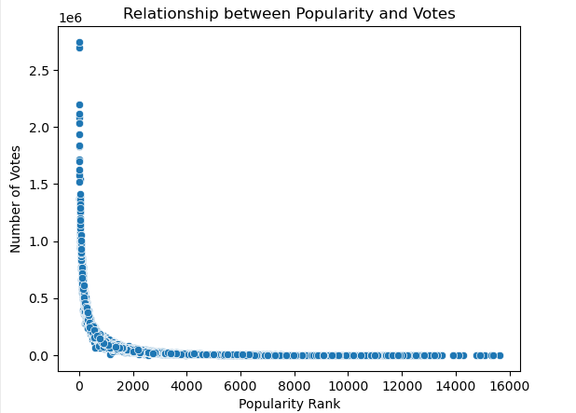
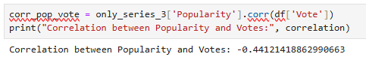
Popularity
vs
Votes
This relationship shows that more popular animes
(lower rank) tend to gather a higher number of Votes.
A negative correlation would indicate this trend.
22

Slide 25
01.
03.
The higher the votes, higher the score
Most common Rating
PG -13
Conclusions
The higher the score, higher position in ranking (smaller number). Hence more popularity
Anime has an increasing trend. Global Phenomena
02.
04.
The higher the score, less quantity of Episodes
Most common Sources: Manga, Novel and Original stories
Current airing animes have better score than animes that finished airing
Most episodes last 24 minutes and have an average score around 7.5.

Slide 26

Thank
you!
thank you!
Drop your questions here

